Slide 1
创建一个数组，并使用索引检索数组元素。
Vocabulary: array, array element, square brackets, index
Notes:
Teacher Notes:
Coders should read aloud the objective.

Slide 2
Connections
到目前为止，我们已经处理了两种数据类型：
数字
字符串
我们使用变量来存储它们。
今天，我们将学习一种存储这些数据类型的新方法。

Slide 3
数组是一种特殊的数据结构，它在单个变量中存储多个值。
let 蔬菜1 =“胡萝卜”；
let 蔬菜2 =“西兰花”；
let 蔬菜3 =“芹菜”；
vs.
let 蔬菜们 = [
“萝卜”，
“西兰花”，
“芹菜”
];

Slide 4
数组的真实示例
数组通常用于表示可以增长或收缩的项目列表，例如：
论坛帖子
购物车或待办事项清单
导航栏

Slide 5
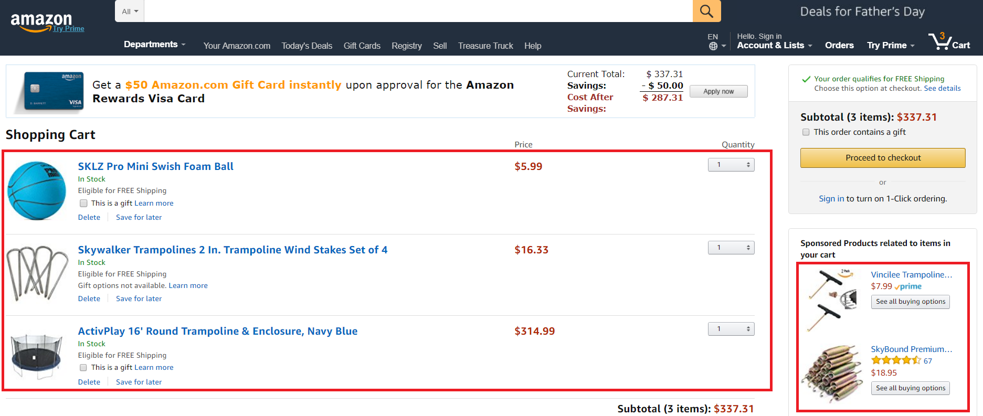
Real world examples of arrays
Notes:
Shopping list and sponsored products

Slide 6
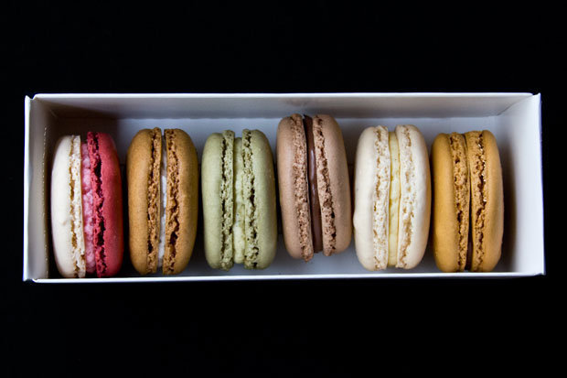
数组语法
将数组想像成一盒Cookie！
方括号就是一个盒子。
let 饼干 = [“浆果”，“咖啡”，“开心果”，“巧克力”，“香草”，“焦糖”];
["🍪", "🍪" , "🍪" , "🍪" , "🍪" , "🍪"];

Slide 7
数组的索引（index）
数组索引是数组元素的位置。
第一个数组索引为0，而不是1。
index 0
index 1
let 老师组 = [“陈老师”, “李老师”, “张老师”,“欧阳老师”, “熊老师"];
index 2
index 3
index 4
Notes:
Students should label the elements in their Guided Notes with the appropriate indeces

Slide 8
停车场：以位置为索引
停车场有几辆车？
您注意到空格上的数字了吗？
0
1
2
3
4
5

Slide 9
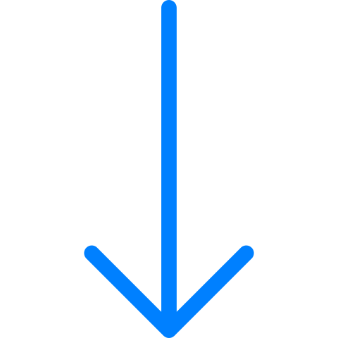
通过索引找到数组中的一个元素
老师组[0] index 0
老师组[1] index 1
let 老师组 = [“陈老师”, “李老师”, “张老师”, “欧阳老师”, “熊老师"];
Notes:
Review syntax of square bracket and index #

Slide 10
How do you create an array?
How do you retrieve an array element at index 0?
编码人员将……
创建一个数组，并使用索引检索数组元素。
Notes:
Say:
Remember, our goal today was to…

Slide 11
给定数组，以下哪一项将找到元素“ Code Nation”并将其存储在新变量favoriteClass中 钉钉投票
let classes = [0"Algebra", 1"Biology", 2"Code Nation", "History", "Spanish"];
let favoriteClass = classes[3];
let favoriteClass = "Code Nation";
let CodeNation = "Code Nation";
let favoriteClass = classes[2];

Slide 12
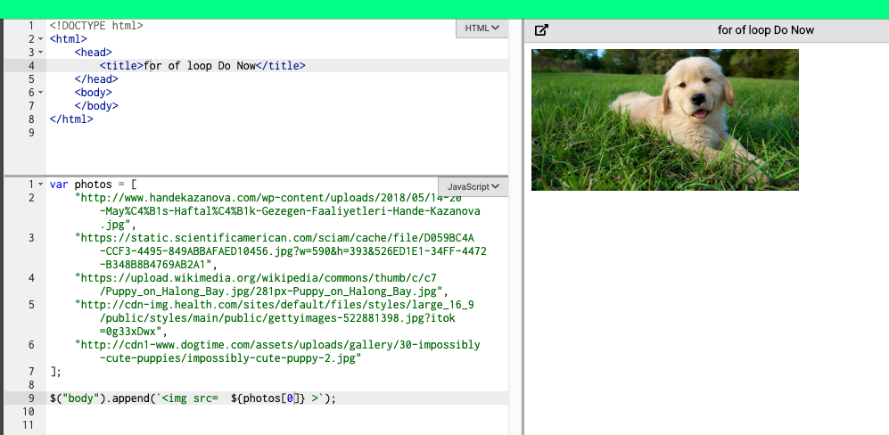
阅读下面的代码。遵循第一个图像的模式，编写JavaScript，该JavaScript将把照片数组中的其余图像附加到页面上。
Paper

Slide 13
类似第一张图像的方法，将照片数组中的其余图像附加到页面上。
Computer

Slide 14
在JavaScript中创建for循环，以便遍历数组。
Vocabulary: array, for of loop, iterate

Slide 15
For循环
for of 循环允许我们遍历数组中的元素，对每个元素执行相同的操作
Notes:
Teacher notes:
Do you think coders at Instagram and writing new code for each image you post??

Slide 16
您如何看待用于循环和迭代的数组将照片添加到此Instagram页面？

Slide 17
for of loop components
for 关键字
数组名
for (let 图片 of 图片们) {
$(“body”).append(`<img src= ${图片}>`);
}
数组元素
每次从数组中选择元素时，我们要执行的代码都在{}内

Slide 18
for of loop syntax
let 数组名 = [“元素1", "元素2", "元素3", "元素4"];
for (let 元素 of 数组名){
$(“div”).动作(元素);
}
Notes:
Teacher notes:
Mention that the array element in a for of loop can be named anything as long as it is consistent

Slide 19
让我们修改代码，编写for循环，将这些小狗照片附加到页面上
Notes:
Have students tell you exactly what to type. They should be participating in live coding, not coding on their own just yet

Slide 20
Here is what a for of loop looks like in JavaScript:
for (let 图片 of photos) {
$(“body”).append(`<img src= ${图片} >`);
}
Does this look familiar? Which parts?
Notes:
Teacher notes:
Point out that this looks similar to a conditional statement
Let students identify what pieces of this loop they know
Syntax breakdown in next slides, don't get into everything here

Slide 21
科技的未来处于危险之中！您必须使用for循环来组装复仇者联盟并保存Code Nation
https://popcode.org/?snapshot=3555d56c-9a81-455e-8d81-00bbde47055d

Slide 22
for循环允许我们如何处理数组？
编码人员将……
在Javascript中创建foreach循环以遍历数组。
Notes:
Say:
Remember, our goal today was to…

Slide 23
What is it called when we use for of to loop over each item in an array?
append
cycle
iterate
avenge

Slide 24
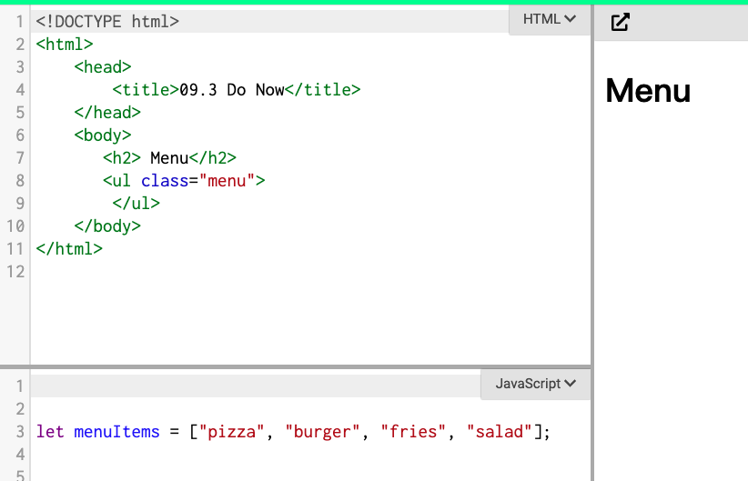
Open up this Popcode
Write the for of loop that appends each item of the array to an unordered list.
Computer

Slide 25
let menuItems = ["pizza", "burger", "fries", "salad"];
Paper
Given this array, write the for of loop to append each element to an unordered list

Slide 26
使用.push将元素添加到数组中，并使用.length获取数组中元素的数量
Vocabulary: array, .push, .length

Slide 27
.push（）是一种用于向数组添加元素的方法。
donuts.push("glazed");
数组名
要加的元素
方法
Notes:
Ask a student to remind the class what an array element is

Slide 28
Using .push()
.push（）总是将元素添加到数组的末尾
let 甜甜圈 = [“香草”，“巧克力”，“草莓”];
甜甜圈.push(“橘子");
[0] [1] [2] [3]

Slide 29
您也可以把变量.push（）进数组
let donuts = ["vanilla", "chocolate", "strawberry"];
let faveFlavor = "glazed";
donuts.push(faveFlavor);

Slide 30
Using .push()
let donuts = ["vanilla", "chocolate", "strawberry"];
let faveFlavor = "glazed";
donuts.push(faveFlavor);
[0] [1] [2] [3]

Slide 31
您还可以使用.push（）将元素添加到空数组
let donuts = [];
let firstDonut = "vanilla";
donuts.push(firstDonut);
[0]
Array with 1 element

Slide 32
.length允许您找出数组中有多少个元素。
let 甜甜圈 = [“香草”，“巧克力”，“草莓”];
甜甜圈.length;
3
What will donuts.length return?

Slide 33
Using .length
let donuts = ["vanilla", "chocolate","strawberry"];
let faveFlavor = "glazed";
donuts.push(faveFlavor);
let numDonuts = donuts.length
4
What is the value of numDonuts?
[0] [1] [2] [3]

Slide 34
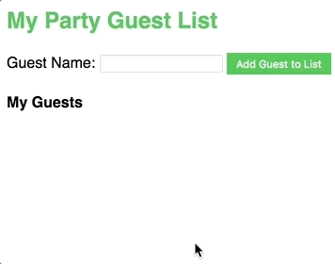
我们将创建一个来宾列表！
让我们一起构建它。
https://popcode.org/?snapshot=8baaf15c-bee5-494d-9f0c-c8275f0881b7
Notes:
Some starter code has been written. This is so GP can focus on practicing the objectives from this lesson. Walk through the instructions and the code provided aloud with students.
Explain the use of a span tag briefly. This has not been formally taught

Slide 35
制定自己的待办事项清单。加入新任务，更新它，并记下您有多少个待办事项！
Mild Medium Spicy
https://popcode.org/?snapshot=47a5f5d1-ae77-4f1d-a540-16312149e1a7
Notes:
This IP is VERY similar to GP. Don't leave GP popcode solution up on the board, but support students to draw the parallels between the two.

Slide 36
What does .push() do?
What does .length() do?
编码人员将使用.push（）将元素添加到数组中，并使用.length获取数组中元素的数量
Notes:
Say:
Remember, our goal today was to…
identify, evaluate, and construct compound conditional statements

Slide 37
阅读以下代码。
如果写在最后，那么donuts.length（）的值是多少？
6
5
7
8

Slide 38
What has been your favorite assignment or project so far?
Share the Popcode screenshot or GitHub repository link to your favorite.

Slide 39
复习JS

Slide 40
您已完成所有Web开发入门课程！
恭喜你！您已经完成了Web开发简介的全部内容。
因此，让我们花一天时间回顾一下您知道的一些新JavaScript：
Variables
Data Types
Input Values
String Interpolations
Conditional Statements
Else-If Multiple Conditions
Compound Conditionals
Arrays
Array Index
For Of Loops
变量
数据类型
输入值
字符串插值
条件语句
否则，如果（多个条件）
复合条件
数组
数组索引
For循环

Slide 41
Let's Review!

Slide 42
But first, a Kahoot!
Let's play a quick review game to show off what we know.
Go to Kahoot.it and join the game with the pin

Slide 43
结课项目
https://popcode.org/?snapshot=6fb88cc2-ac1c-4637-bb4e-03bd0776252e
阶段项目
Open up Drills Practice popcode.
4个作业
Your task is to complete the 4 assignments using your knowledge of JavaScript!
Notes:
Teacher Notes:
Open up the popcode and walk students through how to access the starter code and sample solutions.
They should submit all their completed tasks in one classroom assignment.

Slide 44
Answer the following in Google Classroom:
Which content areas do you feel strongest in?
Which do you feel least confident in?
3) What are you curious to learn next?!

